Slide 1
AQA
AS Level
Computer Science
Paper 1
Selection
Unit 1
Fundamentals of programming

Slide 2
Objectives
be able to use relational operators
be able to use Boolean operations AND, OR
be able to use nested selection statements

Slide 3
IF .. THEN
Program flow is controlled by evaluating a Boolean condition
A Boolean condition evaluates to True or False
If the condition is true then one or more statements are executed
IF condition x is True THEN
execute statements 1, 2, 3…
END IF
If condition x is not true, statements 1, 2, 3.. are skipped and control passes to the next statement

Slide 4
Relational operators
> greater than
< less than
=> greater than or equal to
=< less than or equal to
= equal to (== in Python)
<> not equal to (!= in Python)
Operators vary according to programming languages

Slide 5
Complete the table:
X | Y | condition | True or False?
5 | 4 | X > Y
4 | 4 | X <= Y
10 | 11 | X >= Y
10 | 10 | X >= Y
8 | 9 | X <> Y

Slide 6
IF.. THEN.. END IF
In the example below OUTPUT “Y is less than X” would not be executed as the condition Y < X is not true
X ← 3
Y ← 4
IF X < Y THEN
OUTPUT “X is less than Y”
END IF
IF Y < X THEN
OUTPUT “Y is less than X”
END IF

Slide 7
Complex Boolean expressions
Boolean expressions can include AND, OR and NOT
For example:
IF (grade<0) OR (grade>100) THEN …
Operator | Description
AND | Returns TRUE if both conditions are true
OR | Returns TRUE if either of the conditions is true
NOT | A TRUE expression becomes FALSE and vice versa

Slide 8
Examples
IF age > 12 AND height > 3 THEN
OUTPUT “You can ride the roller coaster”
END IF
IF age <13 OR age > 19 THEN
OUTPUT “You are not eligible for teen discount”
END IF
IF NOT ((age > 12) AND (height > 3)) THEN
OUTPUT “You cannot ride the roller coaster”
END IF

Slide 9
True or false?
Which of the following are true?
X | Y | Z | Condition | True or False?
3 | 4 | 5 | X > Y AND Z > Y
3 | 4 | 5 | X + 3 > Y OR X -2 <= Y
4 | 5 | 6 | (X <= Y AND Y=Z) OR (Z>X)
4 | 5 | 6 | (X <= Y) AND (Y=Z OR Z<X)
3 | 9 | 11 | Y mod X = 0 AND Z mod X = 2
3 | 9 | 11 | NOT ((Z > X) AND (Z > Y))

Slide 10
Boolean expressions
Answers:
X | Y | Z | Condition | True or False?
3 | 4 | 5 | X > Y AND Z > Y | FALSE
3 | 4 | 5 | X + 3 > Y OR X -2 <= Y | TRUE
4 | 5 | 6 | (X <= Y AND Y=Z) OR (Z>X) | TRUE
4 | 5 | 6 | (X <= Y) AND (Y=Z OR Z<X) | FALSE
3 | 9 | 11 | Y mod X = 0 AND Z mod X = 2 | TRUE
3 | 9 | 11 | NOT ((Z > X) AND (Z > Y)) | FALSE

Slide 11
IF .. THEN.. ELSE.. END IF
Often, alternative statements need to be executed if the given condition is not met
The IF .. THEN .. ELSE statement provides this option
IF condition c THEN
statements a, b, c,..
ELSE
statements x, y, z,..
END IF

Slide 12
Example
Which statement would be executed in each of the statements below?
X = 5, Y = 6, A = 9, B = 10
IF X > Y OR A <= B THEN
OUTPUT “Option 1”
ELSE
OUTPUT “Option 2”
END IF
IF X > Y AND A <= B THEN
OUTPUT “Option 1”
ELSE
OUTPUT “Option 2”
END IF

Slide 13
Worksheet 2
Now work through the questions in Task 1 on the worksheet

Slide 14
IF .. THEN .. ELSE IF .. ELSE
Use multiple IF ..THEN.. ELSE IF statements to evaluate more than one condition
What would the output be for each of the following values?
age = 11, age = 12 and age = 13
IF age < 12 THEN
OUTPUT “Age is less than 12”
ELSE IF age = 12 THEN
OUTPUT “Age is 12”
ELSE
OUTPUT “Age is greater than 12”
END IF

Slide 15
CASE .. ENDCASE
A CASE statement is the logical equivalent of the IF.. THEN.. ELSE IF statement
It is used to make it easier to code multiple condition checks
Some languages (e.g. Python) do not have a CASE statement
CASE choice OF
a :OUTPUT “You chose a”
b :OUTPUT “You chose b”
c :OUTPUT “You chose c”
ELSE
OUTPUT “Invalid choice”
ENDCASE

Slide 16
Sample problem
Suppose you need to calculate grades from exam marks and print out the grade for each student
What grade boundaries would you select?
What input would you need?
What conditions would you evaluate?
What output statements would you need?

Slide 17

Worksheet 2
Now work through Task 2 on the worksheet

Slide 18
Nested IF
In the nested IF statement, the second condition is only checked if the first condition is true:
IF x THEN
IF y THEN
OUTPUT “A”
ELSE
OUTPUT “B”
END IF
ELSE
OUTPUT “C”
END IF
OUTPUT “D”

Slide 19
Nested IF
What will the output be if age is (i) 11 (ii) 12 (iii) 13
IF age > 11 THEN
IF age > 12 THEN
OUTPUT “Age Group 1”
ELSE
OUTPUT “Age Group 2”
END IF
ELSE
OUTPUT “Age Group 3”
END IF
OUTPUT “This is the end of the program”

Slide 20
Nested IF vs AND operator
Compare these algorithms. What output would each produce with the following input:
(i) age 10, height 1m (ii) age 10, height .95m (iii) age 9, height 1m
IF age >= 10 AND height >= 1 THEN
OUTPUT “You can ride the rollercoaster.”
ELSE IF age>=10 AND height<1 THEN
OUTPUT “You are too short to ride.”
ELSE IF age < 10 THEN
OUTPUT “You are too young to ride.”
END IF
IF age >= 10 THEN
IF height >= 1 THEN
OUTPUT “You can ride the rollercoaster.”
ELSE
OUTPUT “You are too short to ride.”
ELSE
OUTPUT “You are too young to ride.”
END IF

Slide 21
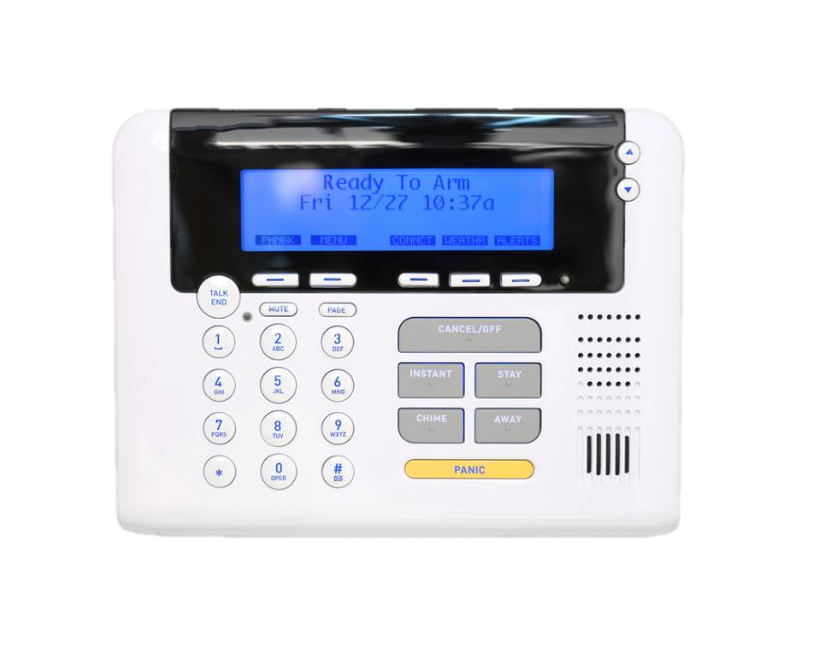
Worksheet 2
Now work through Task 3 on the worksheet

Slide 22
Plenary
IF .. THEN .. ELSE statements can control program flow
relational operators can be used to compare values within the expression
Boolean operators AND, OR can be used to link multiple expressions
ELSE IF can be used to evaluate multiple expressions
CASE can be used to evaluate multiple expressions

